Slide 1
Vibrating string derivation 1D wave equation
From Advanced Engineering Mathematics, Erwin Kreyszig, Fifth Edition, p. 506, Wiley and Sons, 1983

Slide 2
Vibrating string experiment
Strain gauge load cell
Guitar string
Piezoelectric load cell

Slide 3
Assumptions
Assumptions
Mass per unit length is constant = ρ
Can ignore gravitational effects on string.
Bending stiffness is zero.
String moves in one direction.
Each portion of the string only moves normal to the string.
Boundary conditions that u(0,t)=u(l,t)=0
u(x, t)
u
x=0
x=l

Slide 4
Balance forces, use Newton’s Second law to get net force.
= mass/length
T = string tension
Assume string tension is constant while it is oscillating, this means,
This allows us to make some substitutions to simplify the equation
Using the definition of the tangent

Slide 5
Solution of wave equation using separation of variables
Boundary conditions
Initial conditions
Propose the solution is a product of a time and a position based function.

Slide 6
This allows us to separate the time and position equations to yield two, ordinary linear differential equations.
Evaluate partial derivatives
Substitute into the partial differential equation.
Separate equations
Solve individual linear differential equations. Propose that F is given by:
When we evaluate at boundary conditions, we get A=B=0, so k must be negative.
Propose a cyclic function solution.

Slide 7
This now restricts k=-p² which leads to the following linear differential equation:
The general solution to this equation is:
Thus, the final solution to the partial differential equation is:
The first initial condition requires that u(x,0)=f(x), therefore;
The B_{n} values are determined from the Fourier sine series
The B_{n}*are determined from the second boundary condition

Slide 8
If we consider the condition that g(x)=0, which means it is not moving at t=0
This can be rearranged to form the equation for a traveling wave. Use the trig formulas to convert the product of the cosine and the sine;
Going back to the definition of the Fourier series, we recognize that each of the above summations are the odd components of the Fourier series of f. We define that odd extension as f*
These functions are two traveling waves going in opposite directions that are the odd extension of f. The diagrams on the following page show this.

Slide 9
String shape as two waves travel in opposite directions

Slide 10
OK, I am so excited about this derivation, Professor. Now how is this going to help me analyze my lab data?
Going back to the first page, we are reminded that we defined the speed of wave propagation as c and it is a function of the mass density per unit length and the string tension.
The solution to the partial differential equation states that only certain wavelengths are allowed.
If you plot frequency from the FFT vs. n, where n is the frequency order, you should get a straight line with the slope as indicated above which contains variable you measured. Compare your slope with your calculation using the measured values. While you only looked at two tensions, your waveforms have multiple frequency orders.

Slide 11
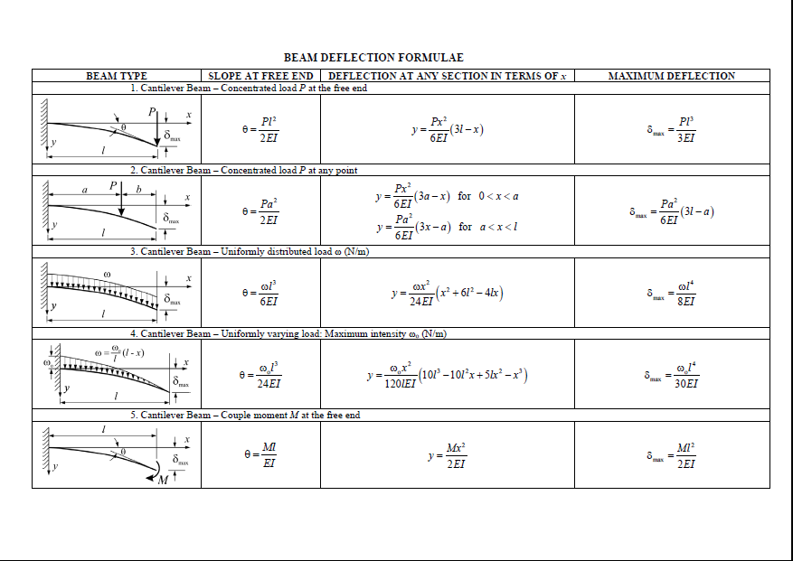
Vibrating cantilever beam equations
The equation for the resonant frequency of a cantilever beam is given below. You can infer the spring constant from the beam deflection formulas (k = P/δ).

Slide 12
Determining damping ratio, ζ
There a many situations where the damping ratio is too hard to determine from adjacent oscillations. When you have many oscillations, you can determine the damping ratio from the following formula. This will be especially useful for the cantilever beam.

Slide 13
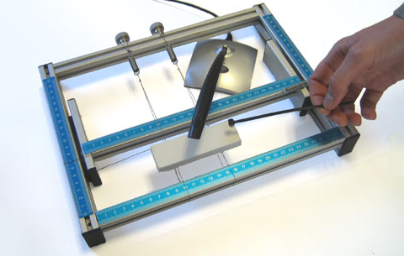
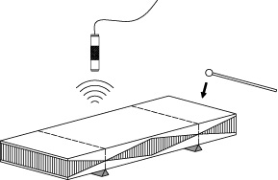
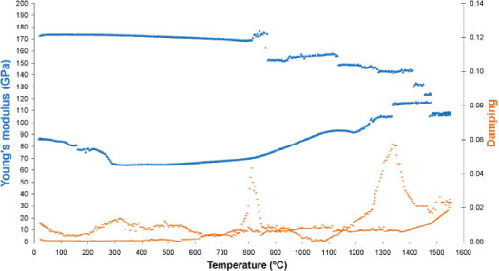
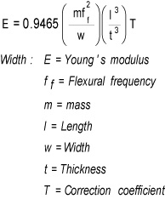
Use of resonance to determine material properties like elastic modulus and damping http://www.imce.eu/youngs-modulus

Slide 14
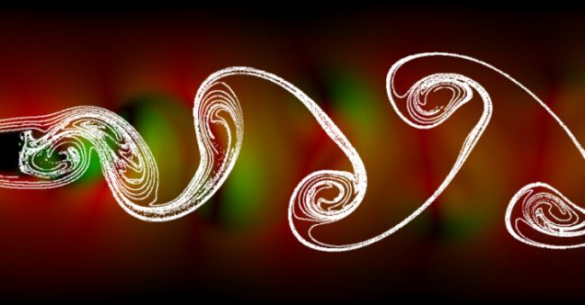
Vibrations Induced by
Fluid Structure Interactions
Karman Vortex Street behind a cylinder visualized by smoke

Slide 15
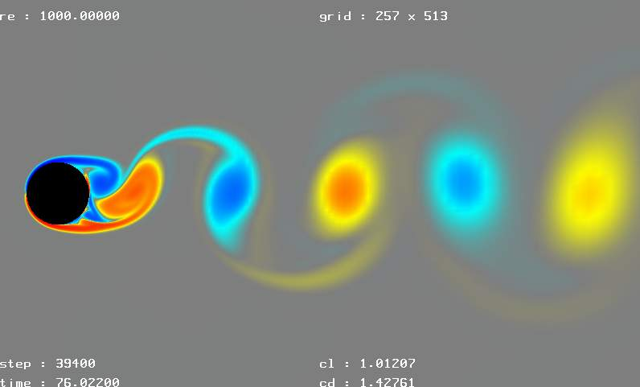
Computational fluid dynamics (CFD)
simulation of vortex street
(structures indicate contours of vorticity)
alternate shedding of vorticity causes periodic variations of the
aerodynamic forces on the body (i.e, vibrations)

Slide 16
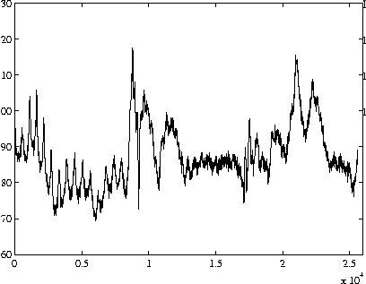
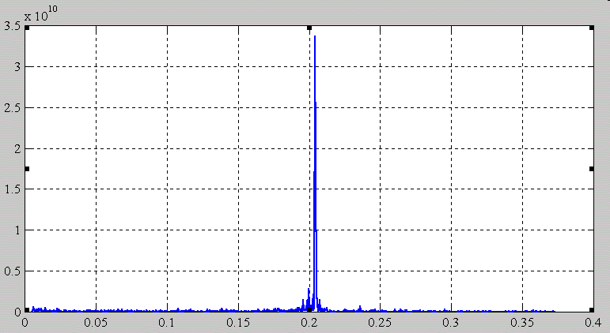
Frequency of Vorticity Shedding
Hot-wire signal
U
volts
d
Hotwire: “hot” resistor used as
one leg of a Wheatstone bridge that
provides a fast measurement of velocity
FFT of hot wire signal
time
shedding
frequency
(f)
amplitude
freq

Slide 17
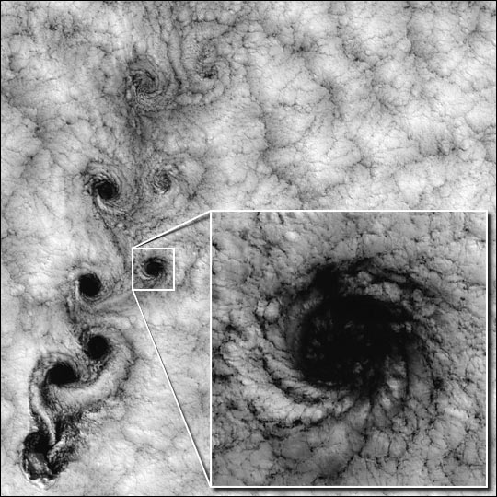
Not just in the lab: Karman vortex street behind
a mountain off the Chilean coast
200 km

